Slide 1


Prometheus and Grafana
An Introduction

Slide 2
Table of content
* What is Prometheus?
* Use Cases
* Targets and Metrics
* Prometheus Architecture
* How Prometheus uses Exporters
* Configuration file setup and node Exporter Example
* Metrics types
* Monitoring your own application with a demo application.
* What is Grafana and PromQL.
* PromQL Examples

Slide 3
What is Prometheus?
Prometheus is a monitoring tool.
It is mainly used for monitoring microservices.
Can be used to monitor containerized applications and traditionally deployed applications.
my-app
My-DB
My-app2
my-app
my-app2
my-app3
Container environment
Servers

Slide 4
What does Prometheus monitor?
Targets | Metrics
Linux / Windows Server, Apache server | CPU Status, Memory Usage , Disk Usage
Applications | Request count, Exception Count, Request duration, Response latency
Databases | Storage size, R/W Latency

Slide 5
Prometheus Architecture

Slide 6
TARGETS
Grafana
Pulls
Accepts promQL queries
Prometheus Server
Data Retrieval Worker
Time Series Database
Http Server
pushes
Retrieves

Slide 7
Collecting Metrics From Targets
Linux Server
/metrics
Data Retrieval Worker
Pulls
External Service
/metrics
Applications
Pulls from <host-address>/metrics endpoint.
/metrics

Slide 8
Targets Endpoints and Exporters
Exporters are used for exposing metrics from Linux, Windows, Apache servers and Services like MySQL, mongo, Kafka etc.
Exporter
Fetches Metrics
Convert to correct format
Expose /metrics
TARGET
Retrieval Worker
Pulls

Slide 9
Demo With Node Exporter

Slide 10
Job and Instances
In Prometheus, an instance is a single target you can scrape.
A collection of instances with the same purpose in called a job.
Job Name
Demo-Application
Instance A : 1.2.3.4:8080
Instance B : 5.6.7.8:8080
Instance C: localhost:8080
Dev
Stage
Targets
Local Machine

Slide 11
Metrics Types
Counter
The counter metrics type is used for any value that increases.
You can query the rate for counter metrics types (how fast the value increases).
e:g Request count , Error count
2. Gauge
The Gauge metrics type can be used for metrics that can increase and decrease.
Don’t use Gauge when you want to query the rate.
e:g Memory usage, CPU usage, Number of request in progress

Slide 12
3. Histogram
The histogram metrics type measure the frequency of value observations that falls into specific predefined category.
E:g request duration,
Observable value : 1s 1.5s 2s 3s
http_request_duration_seconds_bucket{le=“0.5”} 0
http_request_duration_seconds_bucket{le=“1”} 2
http_request_duration_seconds_bucket{le=“2”} 2
http_request_duration_seconds_bucket{le=“3”} 3
http_request_duration_seconds_sum 7.5s
http_request_duration_seconds_count 4
counter

Slide 13
4. Summary
The Summary metrics type is similar to the histogram metrics type. It gives a summary of different categories.
E:g: request duration,
Observable value : 1s 2s 3s
http_request_duration_seconds{quantile=“0.5”} 2
http_request_duration_seconds{quantile=“0.9”} 3
http_request_duration_seconds{quantile=“0.99”} 3
http_request_duration_seconds_sum 7.5s
http_request_duration_seconds_count 4
counter

Slide 14

Demo Application

Slide 15
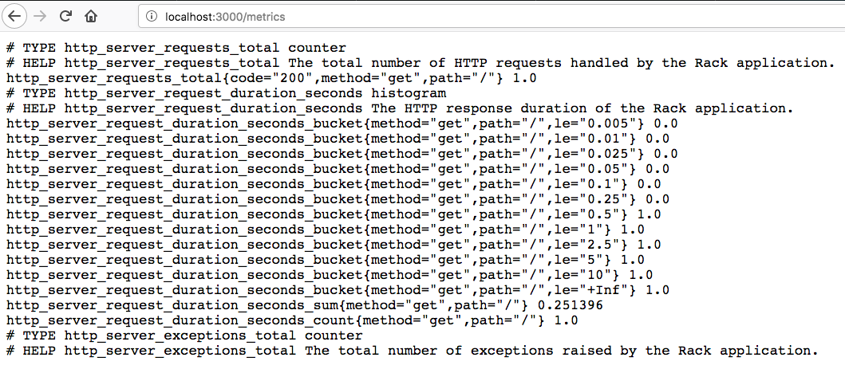
Monitoring your Own Applications
To monitor your own applications, you have to use the client libraries.
Use client libraries to expose /metrics endpoint.
GO Application
/metrics
Prometheus Server
Install client libraries.
Declare and initialize the metrics.
Register the metrics.
Use the registered metrics throughout the application

Slide 16
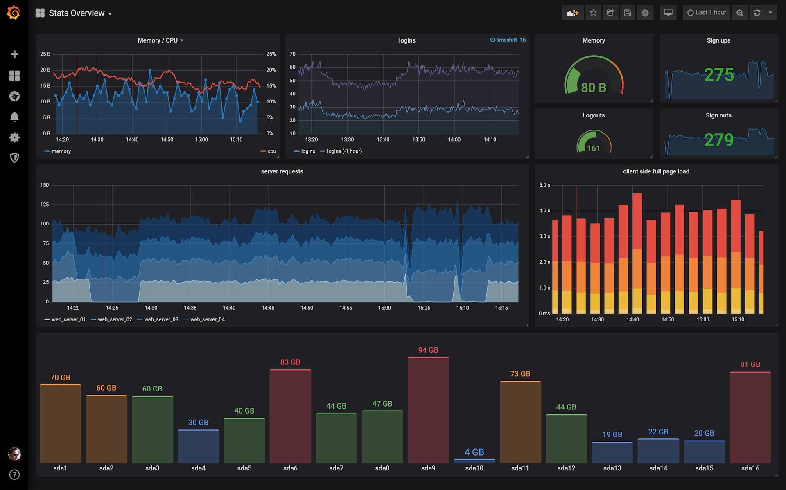
Grafana And PromQL
Grafana is an open-source interactive visualization tool.
Grafana can be used along with Prometheus to visualize the metrics we exposed.
TARGETS
/metrics
PromQL Queries

Slide 17
PromQL Examples
Selecting a time series
http_request_total Selecting the time series with http_request_total
Filtering a time series by using labels
go_routines{job=“location-service”} Filter by the job name “location-service”
Selecting a range of values
http_request_total[5m] Select 5-minute range of sample for the metrics name

Slide 18
rate() vs irate()
Time | Value | Increase
0s | 3 | 3
5s | 5 | 3
10s | 5 | 0
15s | 6 | 3
20s | 7 | 1
25s | 10 | 2
30s | 14 | 4
These functions works for only counter metrics types. Don’t use it of gauge type.
rate() - Per-second rate of increase over a time period
rate(http_request_count[30s]) = (14 – 3) / 30s
Irate() – Per-second rate of increase in the last two samples
Irate(http_request_count[30s]) = (14 – 10) / (30 – 25)s
Request count table

Slide 19
Aggregation over multiple Series
Sum of time series
sum(http_request_total) sum of the time series with http_request_total
Sum by a time series(by keyword)
by keyword group by the specified label
sum(http_request_total) by (job) Filter by the job name “location-service”
Other aggeration functions
max(), min(), count(), count_values(), quantile()
Check out: https://promlabs.com/promql-cheat-sheet/

Slide 20
Thank you

